Slide 1
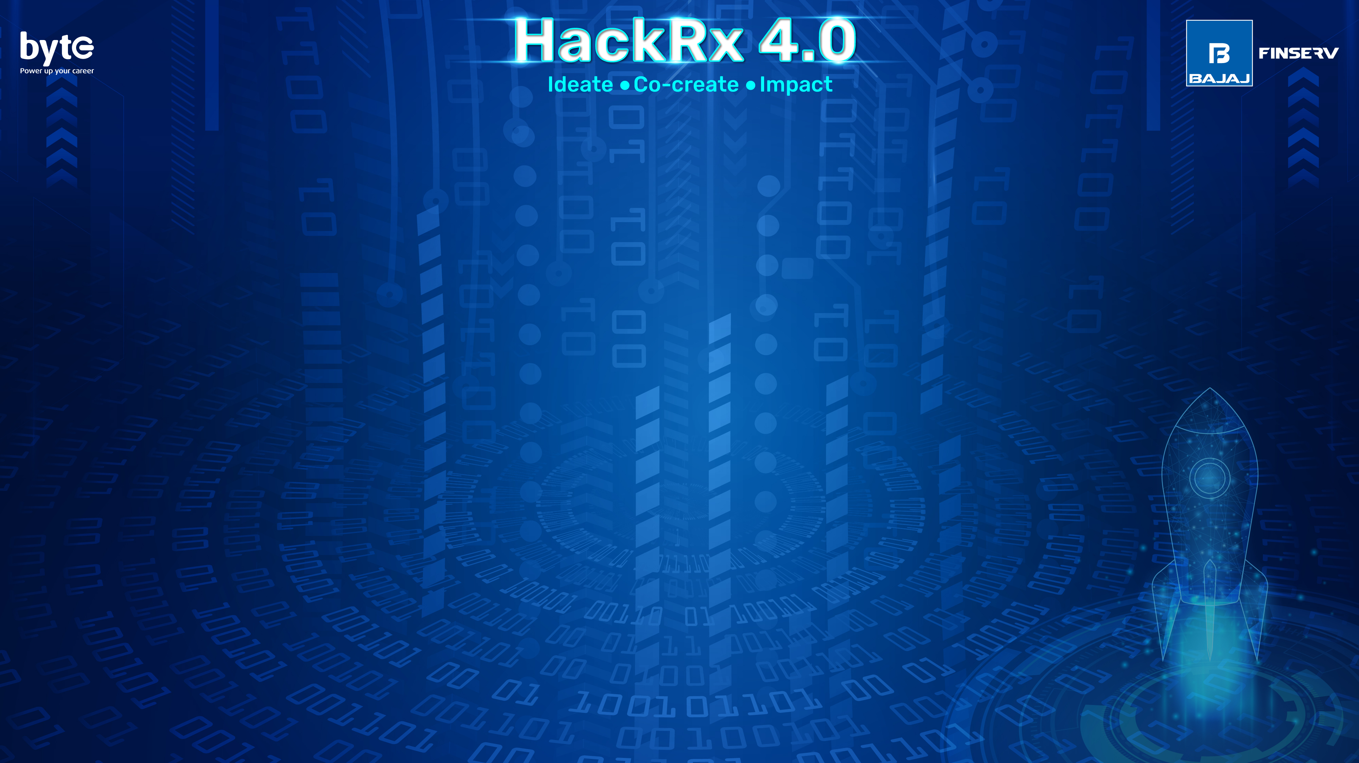
689286-UKA2N661
Vanshita Sharma | 2024 | IIT Guwahati

Slide 2
Tell us a bit about yourself
Past projects that I’ve worked on :
Groundwater management in Brahmaputra basin ( built an ML model)
Covid-19 hotspots predicting ML model integrated with vaccine info for taking needed precaution.
Quantum ML model for CVA prediction
Past Hackathon experiences:
Kaggle hackathon bronze winner
Secured 2nd place in national level quantum computing hackathon
Techgig hackathon semi-finalist (ongoing)
Incode hackathon semi-finalist (ongoing)
Skills : C++, Python, R, Webdev, ML, Data Science.

Slide 3
Selected problem statement : GAMIFICATION OF PERSONAL FINANCE MANAGEMENT
Solution Overview:
The gamified personal finance management app aims to empower users to track their financial habits, improve their well-being, and save more effectively. It incorporates gamification elements, personalized challenges, and social engagement features. The app analyzes user data, including raw data, messages, and emails, to provide insights into spending patterns and financial goals. It also plugs Bajaj markets' financial offerings when relevant, providing users with exclusive deals and discounts.

Slide 4
Process Flow:
1. **User Registration and Onboarding:**
2. **Dashboard and Financial Overview:**
3. **Setting Financial Goals:**
4. **Spending Analysis and Insights:**
5. **Gamification and Challenges:**
6. **Incentives and Rewards:**
7. **Social Engagement:**
8. **Notifications and Reminders:**
9. **Data Security and Privacy:**
10. **Integrations:**

Slide 5
Tech Stack
**Backend:**
- Programming Language: Python, Node.js, or Java
- Framework: Django, Flask (Python), Express.js (Node.js), Spring (Java)
- RESTful API Development
**Frontend:**
- Programming Languages: HTML5, CSS3, JavaScript
- Frameworks/Libraries: React, Angular, Vue.js
- UI/UX Design: CSS frameworks (e.g., Bootstrap, Material UI)
**Cloud Service Providers:**
- Amazon Web Services (AWS)
- Microsoft Azure
- Google Cloud Platform (GCP)

Slide 6
**Database:**
- Relational Database Management System (RDBMS): PostgreSQL, MySQL, Oracle
- NoSQL Database: MongoDB, Firebase Firestore
**Other Details:**
- Data Analysis and Machine Learning: Python libraries like Pandas, NumPy, Scikit-learn, or TensorFlow for analyzing and extracting insights from financial data.
- Integration with Bajaj markets' APIs: Utilize RESTful API integrations and authentication mechanisms provided by Bajaj markets.
- Security and Authentication: Implement secure authentication protocols (e.g., OAuth, JWT) for user authentication and authorization.
- Real-time Notifications: Implement real-time notification mechanisms using technologies like WebSockets or push notification services.
- Containerization: Use Docker for containerization to ensure consistency and portability of the app across different environments.
- Version Control: Utilize Git for version control to track and manage code changes.

Slide 7
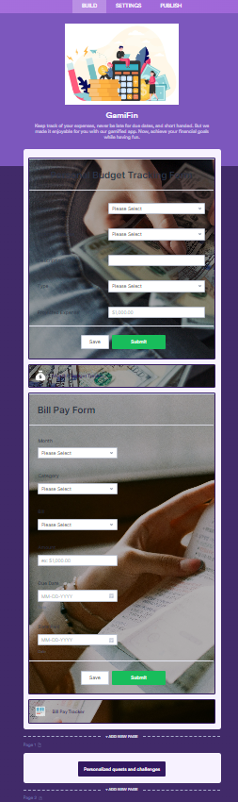
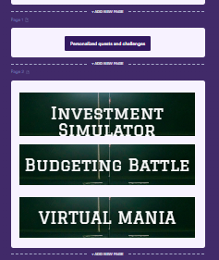
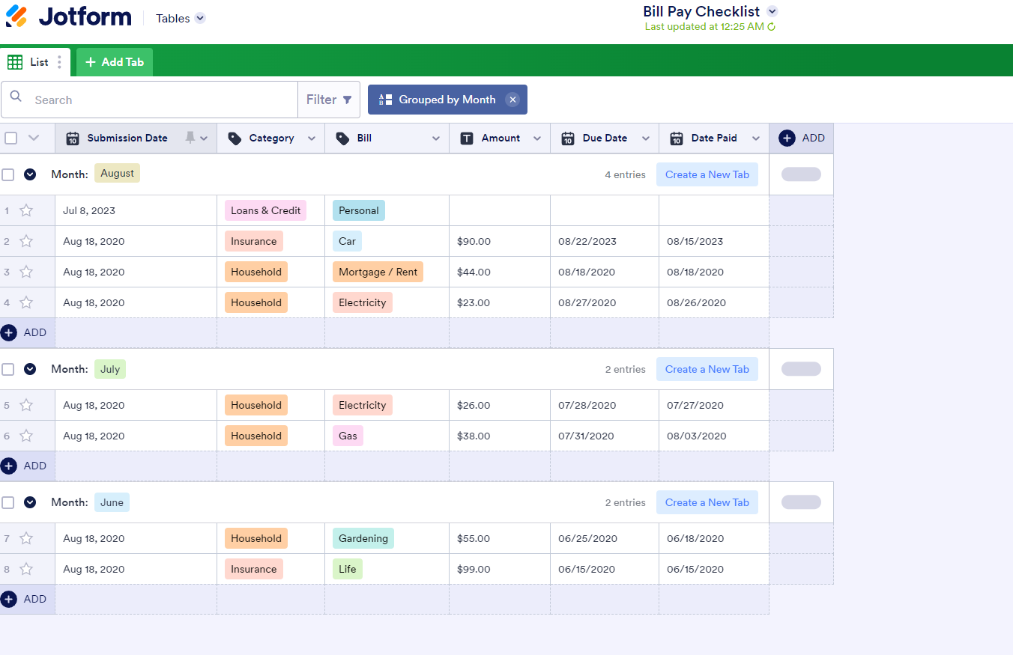
Detailed Description of the solution

Slide 8
Detailed Description of the solution
ML models:
1. EDA: https://www.kaggle.com/code/vanshitasharma/personal-finances-eda
2. Integrating credit default prediction feature: https://www.kaggle.com/code/vanshitasharma/credit-fraud-deal-with-imbalanced-data
Gamified learning:
INVESTMENT SIMULATOR: Invest in real-time and learn while having fun.
FINANCE TRIVIA: Answer finance related questions.
VIRTUAL MANIA: Play and earn coins in virtual world by acquiring quests and redeem them to get Bajaj Finserv services.
BUDGETING BATTLE: A game of maths and wit.

Slide 9
User Registration and Onboarding:
User registers and creates an account using email, social media, or phone number.
Onboarding process guides the user through app features, permissions, and data collection consent.
Dashboard and Financial Overview:
User lands on the dashboard, which displays an overview of their financial status.
Key metrics like income, expenses, savings, and investments are showcased through visualizations.
Setting Financial Goals:
User sets financial goals, such as saving a specific amount or paying off debts.
Goals are inputted with target amounts, deadlines, and descriptions.
Spending Analysis and Insights:
User's transactions, raw data, and additional data (messages, emails) are analyzed.
Categorized spending habits and insights are generated, highlighting areas for improvement.
Gamification and Challenges:
Based on spending analysis, personalized challenges, milestones, or achievements are created for the user.
Challenges could include reducing expenses, increasing savings, or investing in specific assets.
Incentives and Rewards:
Bajaj markets' financial offerings are integrated within the app.
Users earn virtual rewards, badges, or points as they complete challenges or reach milestones.
Users can redeem rewards for discounts or benefits on Bajaj markets' products.
Social Engagement:
Users can interact with each other through a community forum or chat system.
Sharing achievements, goals, and progress on social media platforms is facilitated.
Notifications and Reminders:
Personalized notifications and reminders are sent to users regarding financial goals, challenges, or upcoming payments.
Notifications can be received through push notifications, email, or in-app alerts.
Data Security and Privacy:
User data is securely stored and protected following privacy regulations.
Encryption and authentication mechanisms are implemented to ensure data security.

Slide 10
Data Flow
1. User Registration and Onboarding:
- User provides registration information and creates an account.
- User data is captured and stored securely in the database.
2. User Interactions:
- Users interact with the frontend interface to perform actions such as setting goals, viewing financial insights, and completing challenges.
- User actions generate requests that are sent to the backend server.
3. Backend Processing:
- The backend server receives user requests and validates them.
- User data is fetched from the database for processing.
- Financial insights and challenges are generated based on the user's spending analysis and goals.
4. Integration with Bajaj markets' APIs:
- When relevant, the backend server integrates with Bajaj markets' APIs to retrieve financial product offerings, promotions, or discounts.
- User eligibility and data validation may occur during the integration process.
.

Slide 11
Data Flow
5. Data Analysis:
- Raw data provided by the user, along with additional data from messages and emails, is processed and analyzed.
- Machine learning algorithms are applied to categorize expenses, identify spending patterns, and generate personalized insights.
6. Notifications and Rewards:
- Based on the user's progress, challenges, milestones, or achievements, notifications and reminders are generated.
- Virtual rewards, badges, or points are awarded to the user for completing challenges or reaching milestones.
7. Social Engagement:
- Users can interact with each other through a community forum or chat system.
- Sharing achievements, goals, and progress on social media platforms is facilitated.
8. User Data Storage:
- User data, including profile information, transaction details, and financial goals, is securely stored in the database.
- Data encryption and proper security measures are implemented to protect user privacy.

Slide 12
So, how is your solution different?
USP of my approach:
1. **Personalized Gamification:** The app offers a highly personalized gamification experience by analyzing the user's spending habits and financial goals. Challenges, milestones, and achievements are tailored to each user's specific needs, motivating them to improve their financial habits and save more effectively.
2. **Integration with Bajaj markets' Financial Offerings:** The app seamlessly integrates with Bajaj markets' financial products and services. Users can access exclusive deals, discounts, and promotions directly within the app, providing them with convenient options to explore and utilize financial offerings.
3. **Social Engagement and Community:** The app fosters social engagement by providing a platform for users to interact with each other. Users can share their achievements, seek advice, and participate in discussions related to personal finance, creating a sense of community and support.

Slide 13
4. **Alternate Data Analysis:** In addition to the raw data provided by the user, the app utilizes machine learning algorithms to analyze alternate data sources such as messages and emails (with user consent). This allows for a more comprehensive understanding of the user's financial behavior and provides enhanced insights for personalized challenges and recommendations.
5. **Real-time Notifications and Insights:** The app keeps users engaged and informed through real-time notifications and reminders. Users receive updates on their financial goals, challenges, and progress, helping them stay on track and make informed decisions about their finances.
6. **User-friendly Interface and Experience:** The app prioritizes user experience by offering an intuitive and visually appealing interface. It provides easy navigation, clear visualizations of financial data, and a seamless user journey, ensuring that users can effortlessly manage their finances and engage with the app.
7. **Data Privacy and Security:** The app places a strong emphasis on data privacy and security. It adheres to relevant regulations, encrypts sensitive user information, and implements secure authentication mechanisms, ensuring that user data is protected.
.

Slide 14
Future possible enhancements
1. **Artificial Intelligence (AI)-Driven Recommendations:** Implement advanced AI algorithms to provide personalized financial recommendations based on users' spending patterns, financial goals, and market trends. This could include suggestions for optimizing savings, investment opportunities, or debt management strategies.
2. **Predictive Analytics:** Utilize predictive analytics to forecast future financial trends and potential risks. This can help users make proactive decisions, anticipate changes in their financial situation, and take preventive measures accordingly.
3. **Automated Expense Tracking:** Integrate with financial institutions or leverage technologies like optical character recognition (OCR) to automate expense tracking. This would eliminate manual data entry, providing users with more accurate and real-time insights into their spending habits.
4. **Financial Education and Learning Resources:** Offer educational content, articles, videos, and interactive modules within the app to enhance users' financial literacy. This would empower users with knowledge and skills to make informed financial decisions.
5. **Smart Budgeting and Expense Allocation:** Develop intelligent budgeting features that analyze users' income, expenses, and financial goals to suggest optimal budget allocations. The app could provide notifications and recommendations to help users stay within their budget and achieve their financial objectives.
6. **Integration with Personal Finance Tools and Services:** Collaborate with third-party personal finance tools, such as expense trackers or investment platforms, to offer seamless integration and provide users with a comprehensive financial management ecosystem. This would enable users to access and manage their financial data from a centralized platform.
These future enhancements aim to further enhance the app's functionality, user experience, and value proposition. By incorporating AI-driven recommendations, predictive analytics, automation, education, and strategic integrations, the app can continuously evolve to meet the changing needs of users and provide them with a comprehensive and empowering personal finance management solution.

Slide 15
Risks/ Challenges / Dependencies
- Data Privacy and Security
- Data Accuracy and Quality
- Integration with External APIs
- User Adoption and Engagement
- Regulatory Compliance
- Technology Scalability and Performance
- Competitor Landscape and Market Differentiation
- User Education and Financial Literacy
- Cross-Platform Compatibility
- Ongoing Maintenance and Updates
- Partner Collaboration and Integration Support
- User Trust and Perception of Data Handling

Slide 16
Acceptance Criteria Coverage
- Successful user registration and onboarding process
- Accurate and up-to-date financial metrics on the dashboard
- Clear visualization of financial data through charts and graphs
- Ability to set, track, and receive notifications about financial goals
- Accurate categorization of expenses and generation of insights
- Personalized challenges, milestones, and achievements based on spending analysis and goals
- Earning virtual rewards, badges, or points for completing challenges or reaching milestones
- Redemption of rewards for discounts on Bajaj markets' financial offerings
- User engagement through community forum or chat system
- Ability to share achievements and progress on social media platforms
- Secure storage and protection of user data
- Adherence to data protection regulations and implementation of encryption and authentication mechanisms

Slide 17
Agile implementation:
- Iterative development with regular sprints, allowing for incremental feature development and frequent feedback from users and stakeholders.
- Cross-functional teams consisting of developers, designers, and domain experts to ensure a collaborative and diverse approach to app development.
- Close collaboration with users and stakeholders throughout the development process to gather requirements, validate ideas, and incorporate feedback.
- Adaptive planning, adjusting priorities and features based on user feedback, market trends, and changing needs.
- Continuous integration and delivery, allowing for frequent releases and updates to deliver value to users at shorter intervals.
- Regular reviews with stakeholders to validate progress, gather feedback, and make necessary adjustments to ensure alignment with user expectations.
- Retrospectives held within the development team to reflect on the process, identify areas for improvement, and make adjustments for increased efficiency and quality.
- Embracing change by maintaining flexibility in the development process, accommodating new insights, and responding to evolving user needs.
- Agile project management frameworks like Scrum or Kanban can be adopted to provide structure, roles, and ceremonies that support Agile principles.

